Slide 1
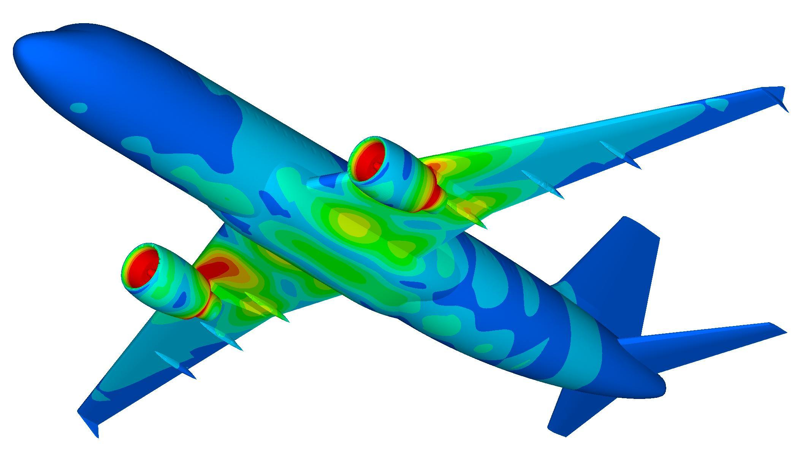

2D Fast Multipole Boundary Element Method Algorithm Implementation and Analysis in Modern Engineering

Slide 2
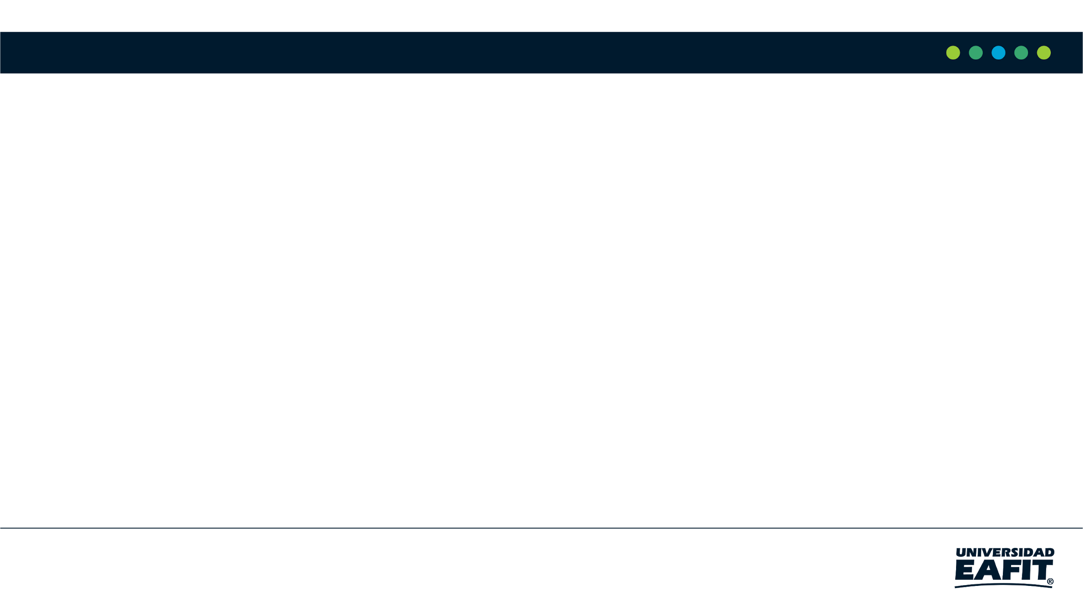
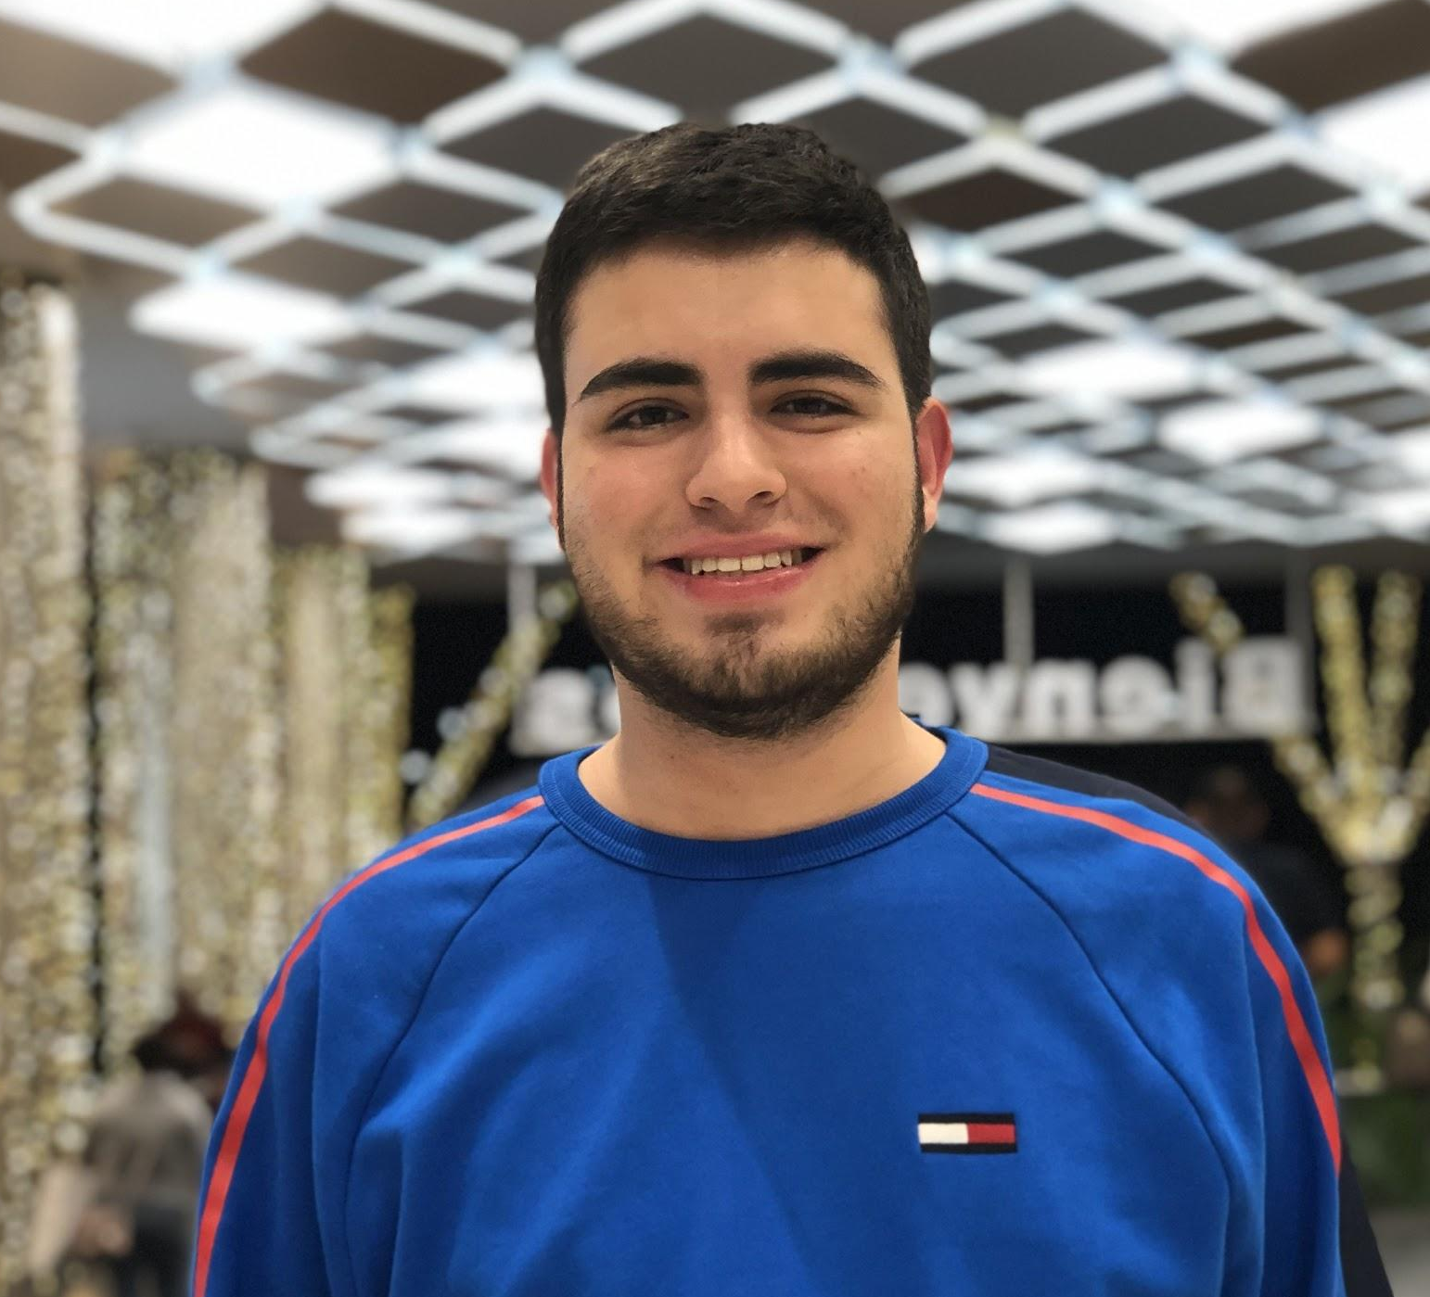
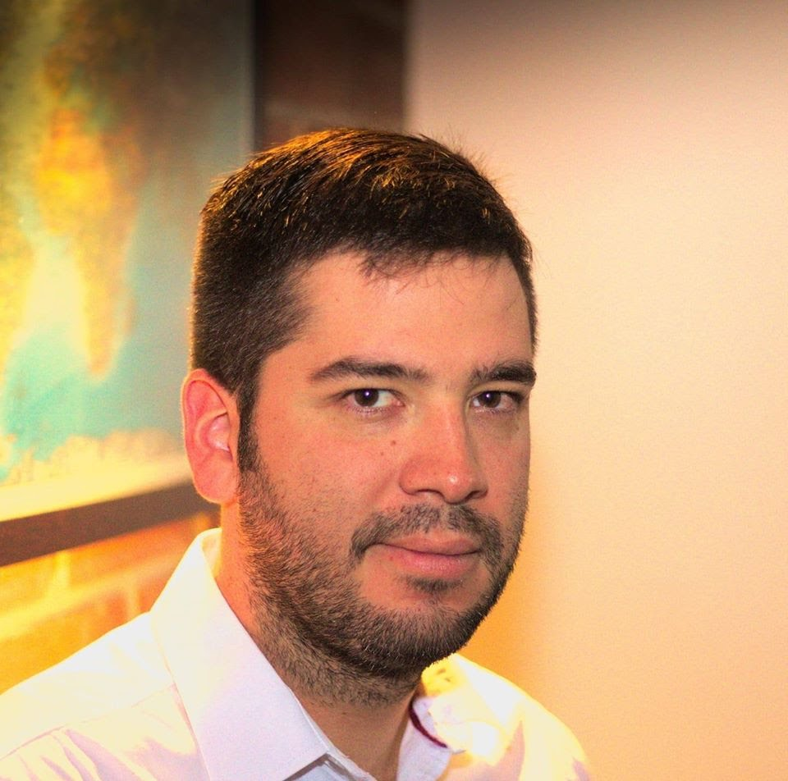


Team Presentation
Juan Camilo Gutierrez U
Simón Marín
Mauricio
Toro
https://github.com/Jcgutierru/ST0245-001/tree/master/proyecto

Slide 3
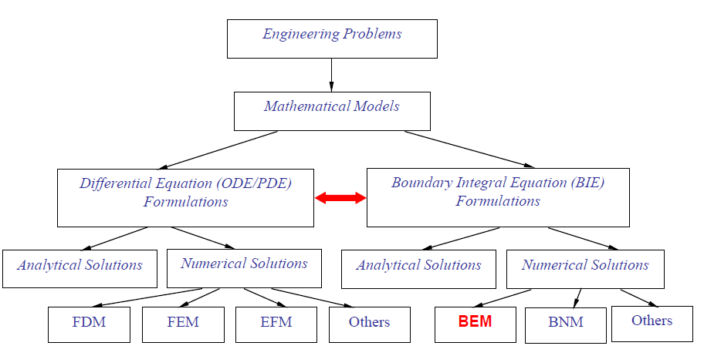
Mathematical Models

Slide 4
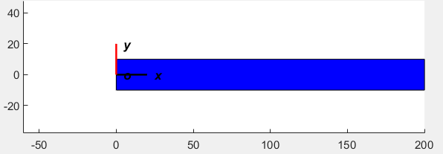
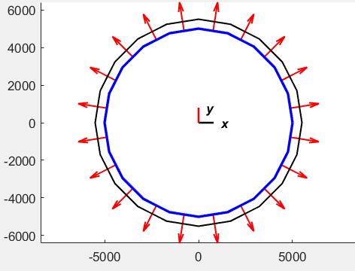
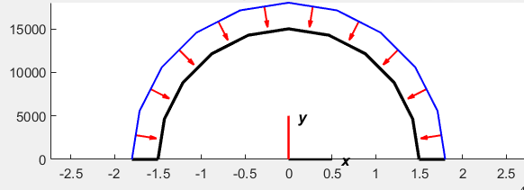
Stress-Deformation Problems
Cantilever Beam
Tank
Tunnel

Slide 5

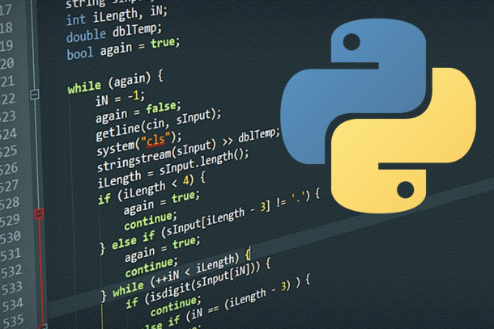


Softwares
IBEM
BEM
Discretization
FEM

Slide 6
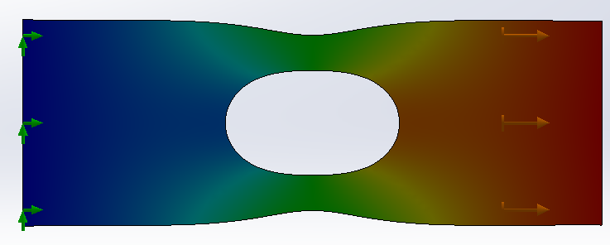
Engineering Problem
Geometry
Iterative algorithms
Materials
Numerical Method
Solution
Loads and/or displacements

Slide 7
Stress-Deformation Problems
Material
-Aluminium Alloy 2014-T6:
Elastic Modulus, E= 72400 N/mm²
Poisson coefficient, Nu = 0.33
Shear Modulus, G = 28000 N/mm²
Geometry
Loads and displacements
Cantilever beam
Distributed load in left side100 N/mm²
L = 200 mm
h = 20 mm
b = 1 mm

Slide 8
BEM Simplification
Y
6
N1
z
N4
N2
x
1
N3
X
0,0
3
8

Slide 9
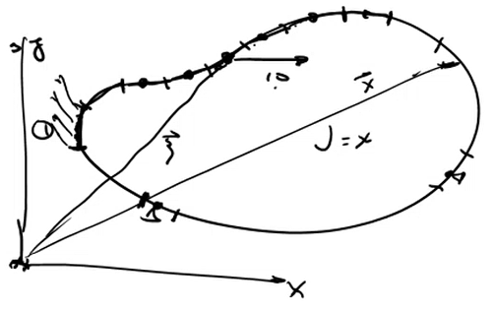
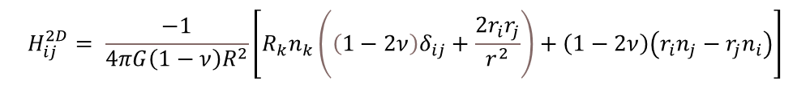
Boundary Element Method main equations
Elastodinamic Representation Theorem
$$U_{ij}\left(ξ\right)=\int_{S}{G_{ij}\left(x,ξ\right)∗ t_{i}\left(x\right)∗ds\left(x\right)− \int_{S}{H_{ij}\left(x,ξ\right)∗ u_{i}\left(x\right)∗ds\left(x\right)+\int_{V}{G_{ij}\left(x,ξ\right)∗ P_{i}\left(x\right)∗ds\left(x\right) } }}$$
Green Functions
$$H_{ij}^{2D}= \frac{−1}{4πG\left(1−ν\right)R^{2}}\left[R_{k}n_{k}\left(\left(1−2ν\right)δ_{ij}+\frac{2r_{i}r_{j}}{r^{2}}\right)+\left(1−2ν\right)\left(r_{i}n_{j}−r_{j}n_{i}\right)\right]$$
$$G_{ij}^{2D}= \frac{1}{8πG\left(1−ν\right)}\left[\left(3−4ν\right)δ_{ij}\ln\left(\frac{1}{r}\right)+\frac{r_{i}r_{j}}{r^{2}}\right]$$

Slide 10
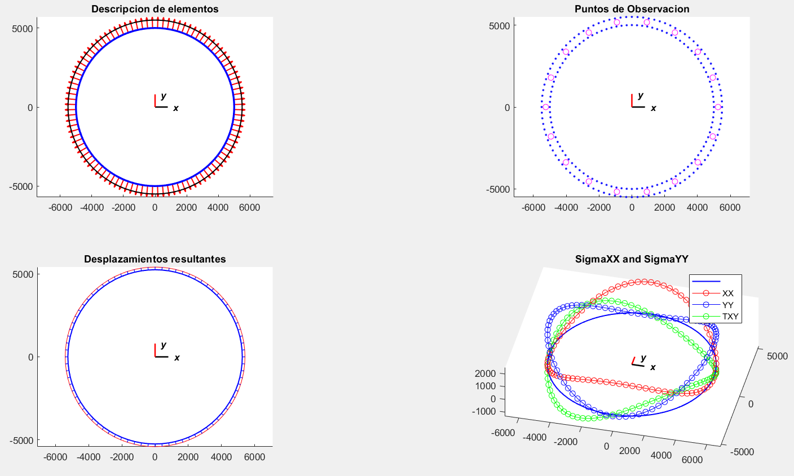
Matlab IBEM results

Slide 11
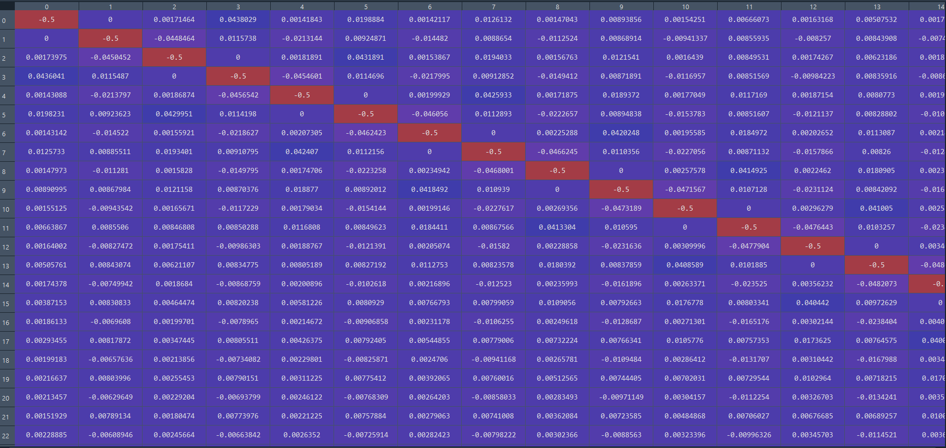
Data Structures
Static Vectors

Slide 12
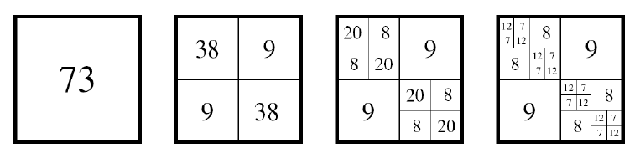
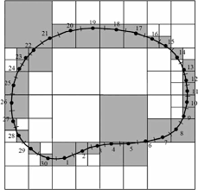
Data Structures
Quadtrees/Octrees

Slide 13
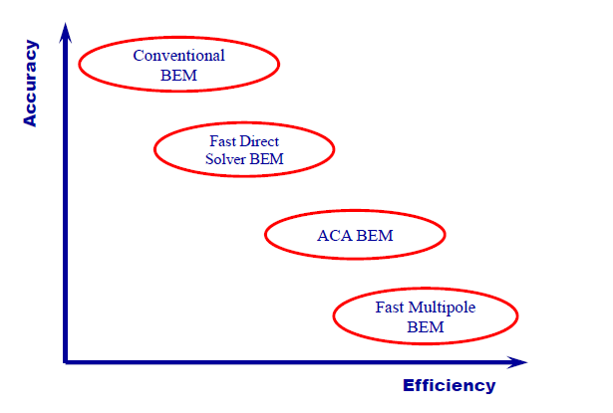
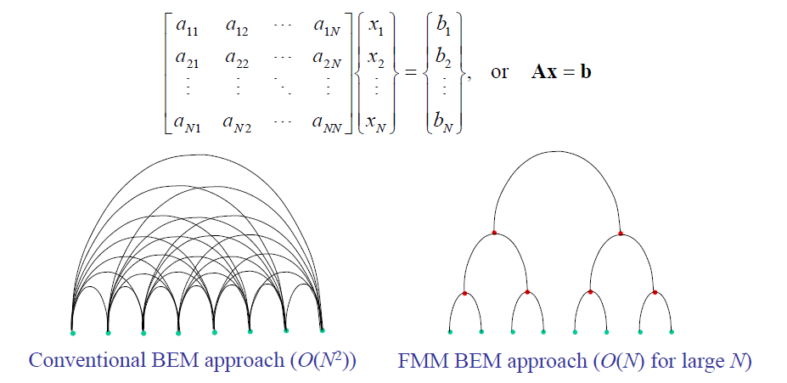
Fast Multipole Method

Slide 14
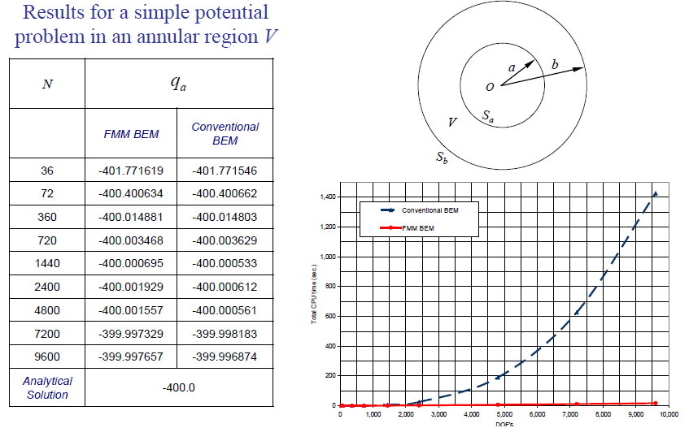
Compression Algorithm Complexity
 | Time Complexity | Memory Complexity
BEM | O(N²) | O(N²)
FMBEM | O(N) | O(N)

Slide 15
THANK YOU!.
Supported by
The first two authors are supported by a Sapiencia grant financed by Medellín municipality. All the authors would like to thank the "Vicerrectoría de Descubrimiento y Creación", of Universidad EAFIT, for their support on this research

